Slide 1
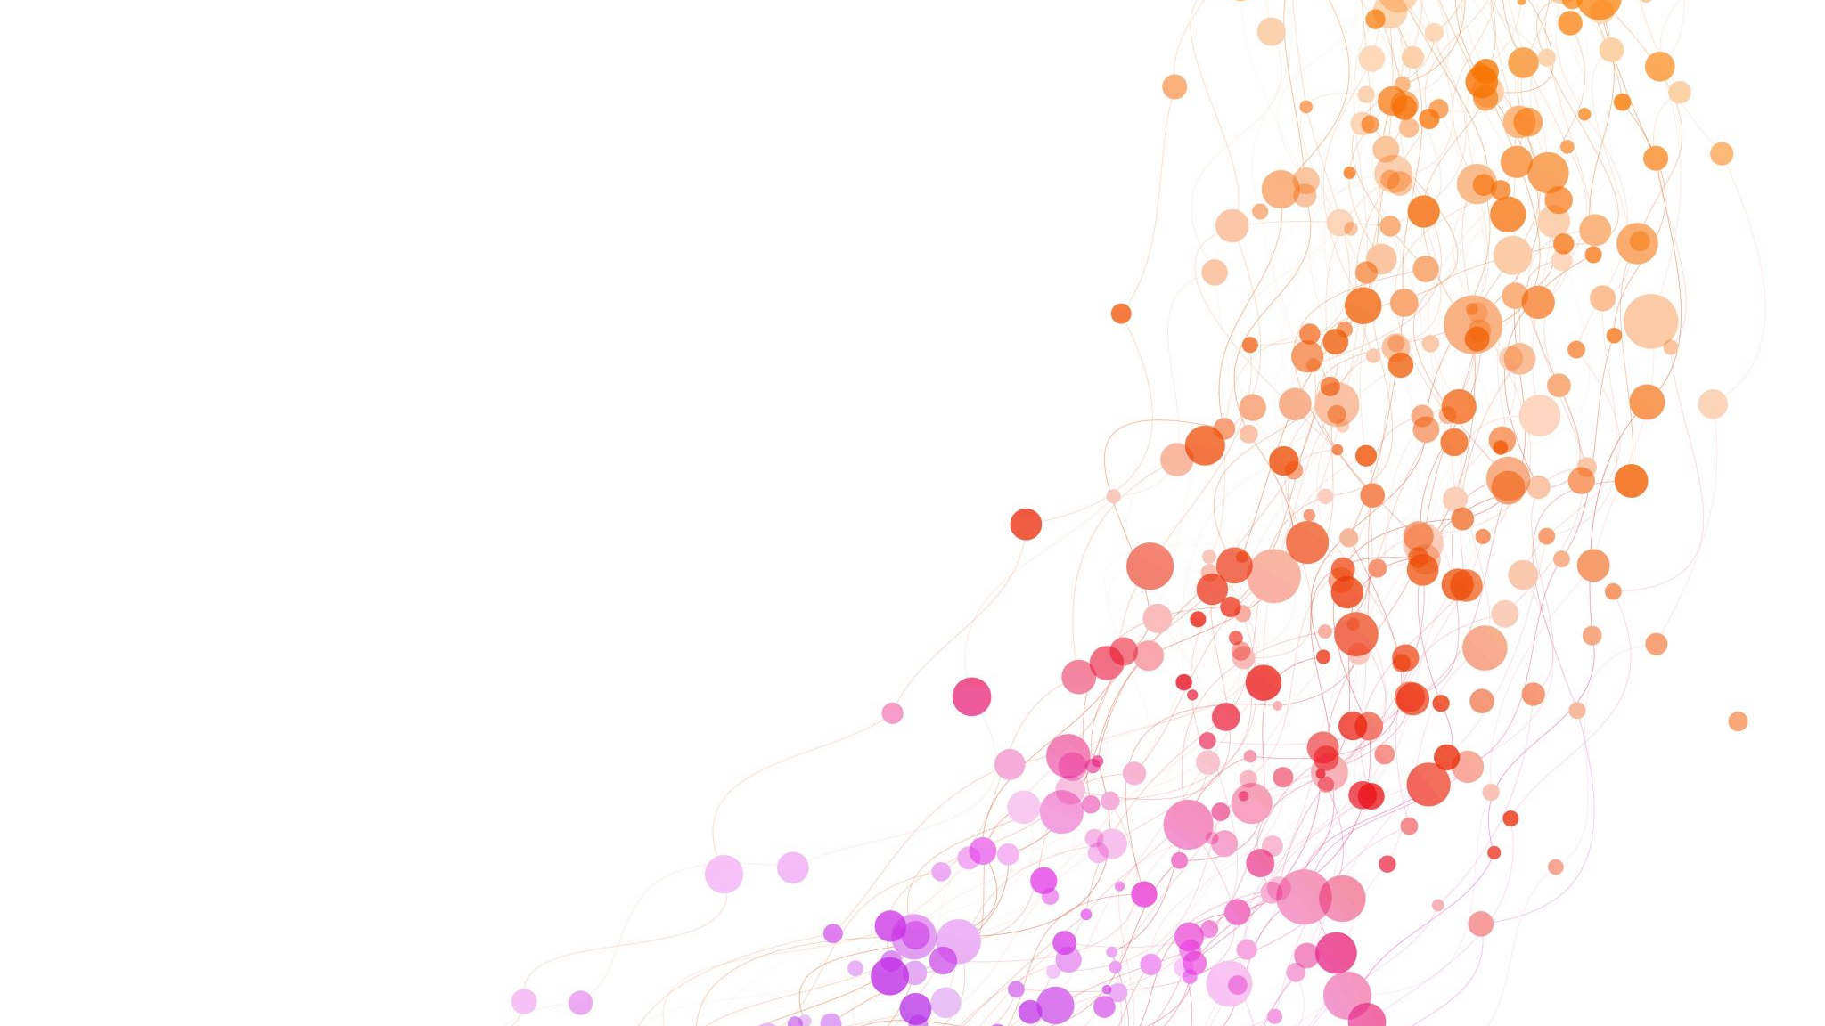
Make it short Computer System 1st team presentation
Lim Saeyeon / Yang Juchan

Slide 2
contents
1. Task Introduction
2. Solution
3. Result
4. Another Trial

Slide 3
Task Introduction

Slide 4
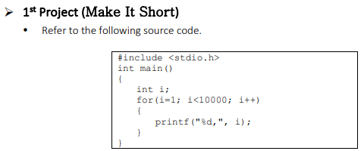
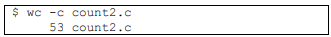
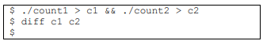
Task Introduction

Slide 5
Task Introduction
1 #include <stdio.h>
2 int main()
3 {
4 int i;
5 for (i=1; i<10000; i++)
6 {
7 printf(“%d,”, i);
8 }
9 }
Standard input/output library
Program starts with main() function
(which returns integer and no parameters)
Declare integer value named ‘i’
Initialize i to 1, and repeat add 1 for i is less than 10000
Within the loop, print the value of i, separating each with ‘,’

Slide 6
Solution

Slide 7
Delete
1 #include <stdio.h>
2 int main()
3 {
4 int i;
5 for (i=1; i<10000; i++)
6 {
7 printf(“%d,”, i);
8 }
9 }
In some cases, certain standard functions like ‘printf’ are automatically linked by the compiler without the need to specify them separately, by including the header file
Automatically default the return type to int when omitting the return value in function definition
Removing the newline does not affect the code
Notes:
for more info. 컴파일 단계에서 해당 라이브러리가 명시적으로 연결되었을 경우,
1) 함수가 라이브러리에 정의되어 있고,
2) 해당 라이브러리가 명시적으로 컴파일 및 링크 프로세스에 포함된 경우,
함수를 사용할 수 있음

Slide 8
Condensation
1 main(i)
{int i;
for (i=1; i<10000; i++)
{printf(“%d,”, i);}}
10000 can be expressed as 1e4
You can omit the initialization and perform increment or decrement in the execution statement
In C99 version and later, if a program terminates without issues, the function returns 0 even if you don't explicitly specify a return statement
Section 5.1.2.2.3 of C99 TC3, Part 0

Slide 9
Result

Slide 10

Execution Record

Slide 11
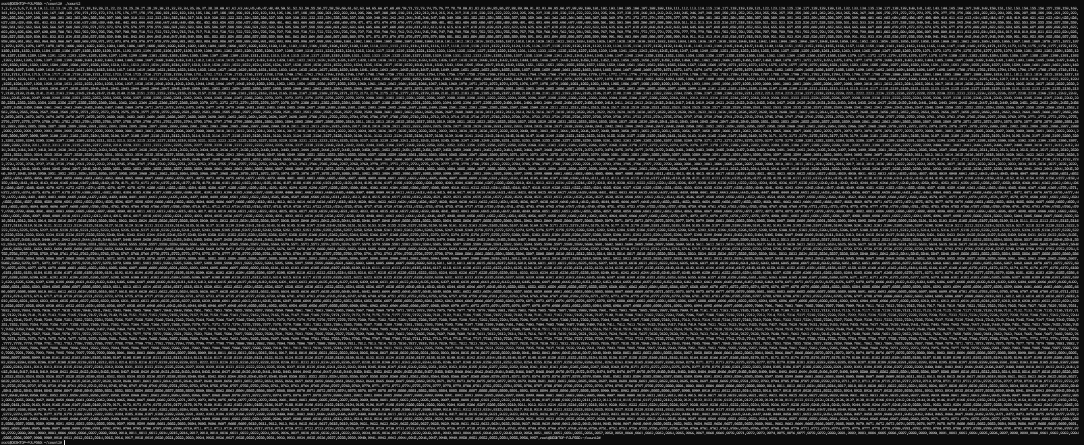
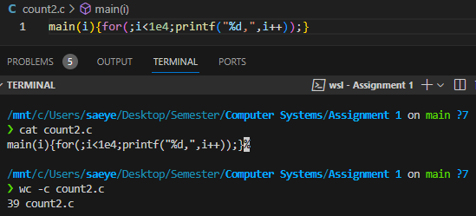
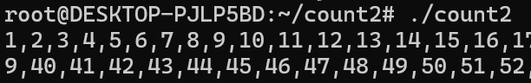
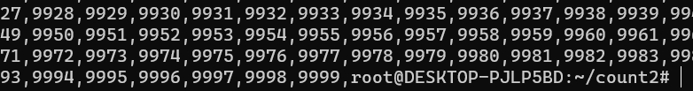
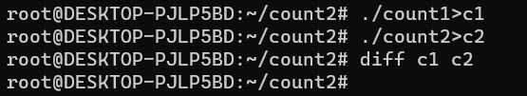
Execution Result
main(i)(for(;i<1e4;printf(“%d,”, i++));}
-> print 1 to 9999

Slide 12

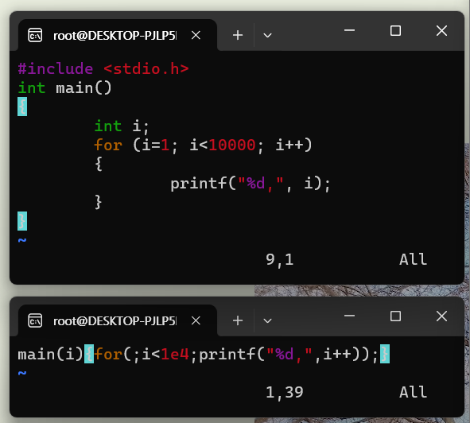
Satisfactions with Conditions
Same execution result
Less than 53 bytes
Total 39 bytes
Less than 42 bytes
For statement
No ‘While’ or ‘For’

Slide 13
Another Trial

Slide 14
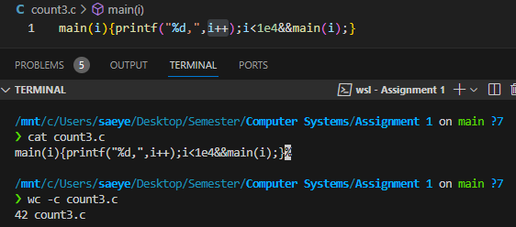
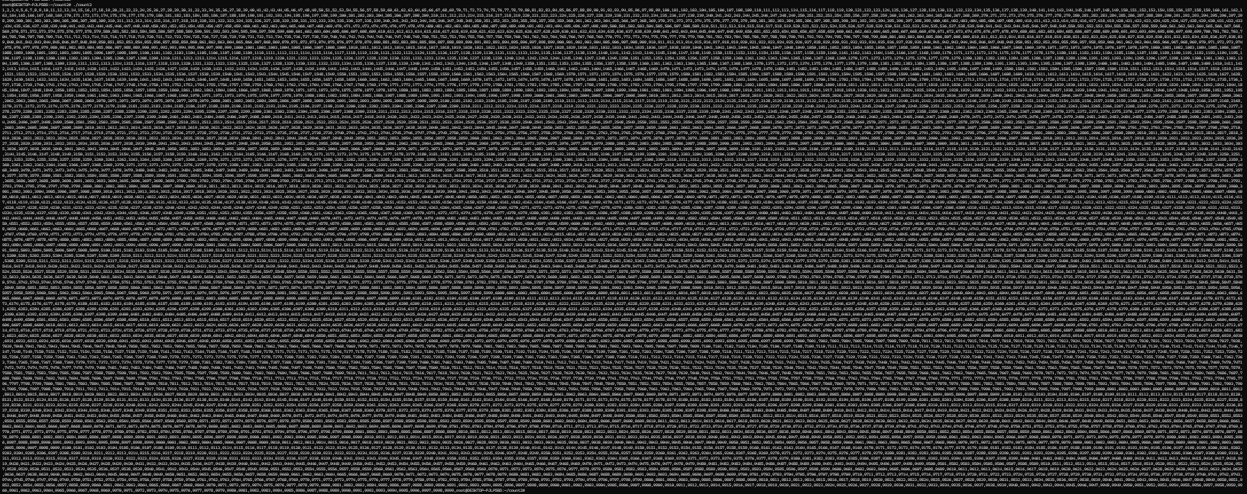
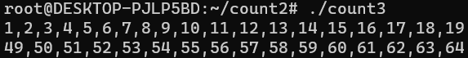
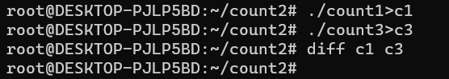

Execution Result
main(i){printf(“%d,”, i++);i<1e4&&main(1);}
-> print 1 to 9999

Slide 15
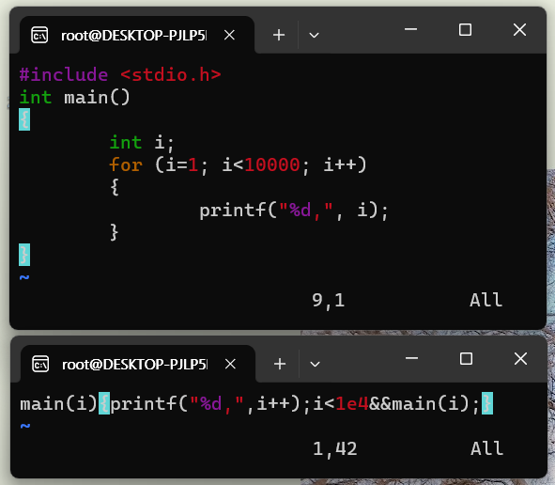
Satisfactions with Conditions
Same execution result
Less than 53 bytes
Total 42 bytes
Less than 42 bytes
No ‘While’ or ‘For’

Slide 16
Make it short Computer System 1st team presentation
Thank You

